Slide 1


Using Genetic Programming for Making a New Evolutionary Artwork, Based on Human-Computer Interactions for Autism Rehabilitation
Seyed Muhammad Hossein Mousavi
Narges Aghsaghloo
1

Slide 2
Sections:
Introduction
Evolutionary computations (EC)
Genetic algorithm and programming
Evolutionary art
Autism
Autism rehabilitation or therapy
Related prior works
Proposed unsupervised evolutionary artwork
Terminal and Function sets
Validation and results
Aesthetic measure (fitness function)
Global Contrast Factor (GCF)
Information Theory (IT)
Therapy result
Conclusion
Some important References
2

Slide 3

Introduction
Introduction:
Image processing application in, entertainment, industry, medicine, engineering and …
Image processing techniques in psychology and rehabilitation
Evolutionary Computations (EC), are nature inspired algorithms
Algorithms which uses EC are called Evolutionary algorithms (EA)
Using evolutionary algorithms could create Evolutionary Art (EA)
Which is possible to use it for painting therapy
As autistic people needs different and unknown ways to learn and rehabilitate
It is possible to use EA to rehabilitate people with Autistic Spectrum Disorder (ASD)
3
Using Genetic Programming for Making a New Evolutionary Artwork, Based on Human-Computer Interactions for Autism Rehabilitation

Slide 4
Introduction
Evolutionary Computations and Evolutionary Algorithms (EA):
EC are inspired by nature for solving mathematical problems.
Algorithms which uses EC is called EA and each EA have:
Initial population (individuals)
Generations
Selection (Parents) (Roulette wheel)
Recombination (Depends)
Mutation (Small random change in each generation on individuals)
Candidate solution iteratively (step by step) updated
Updating Fitness or cost function (Evolve)
Selection (New) (Roulette wheel)
Has application in:
Optimization-Clustering-Regression-Edge detection and more
4
Using Genetic Programming for Making a New Evolutionary Artwork, Based on Human-Computer Interactions for Autism Rehabilitation

Slide 5
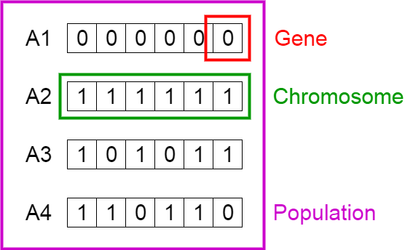
Introduction
Genetic Algorithm (GA) and Genetic Programming (GP):
GA is an EA just like PSO, ABC, BAT algorithm, GGO, ICA and more
Inspire from nature ( Biological actions=bio-inspired)
Recombination (Cross over)
Mutation (Changing in a gene or bit in chromosome )
GP is interface of GA in schema of a computer program not a string like GA.
5
Using Genetic Programming for Making a New Evolutionary Artwork, Based on Human-Computer Interactions for Autism Rehabilitation

Slide 6
Introduction
Evolutionary Art (EA):
Artist does not make the work
System make the construction
Putting system in iterated process of selection and modification to arrive at a final product
Artist is the selective agent
Human-computer interaction (HCI) that human orders and computer generates
Computer make the next art or artwork according to selected artworks
Here GA is employed to generate visual artwork
It could be used in sound and signal processing to make music
6
Using Genetic Programming for Making a New Evolutionary Artwork, Based on Human-Computer Interactions for Autism Rehabilitation

Slide 7
Introduction
Autism and autistic people:
Autistic people known as people with Autistic Spectrum Disorder (ASD)
Troubles with social interaction and communication
Repetitive behavior is the main sign
Signs in the first two or three years of their child's life will appear
Develop step by step, and get worse through time
Autism is caused by a combination of genetic and environmental factors
Risk factors include certain infections along pregnancy such as alcohol, or cocaine and …
Affects information processing in the brain by changing how nerve cells and their synapses connect and organize
How this occurs is not well understood
7
Using Genetic Programming for Making a New Evolutionary Artwork, Based on Human-Computer Interactions for Autism Rehabilitation

Slide 8
Introduction
Autism rehabilitation or therapy:
Autism therapies are interventions that attempt to reduce problem behaviors
In order to increase the quality of life
Treatment is typically depends on person's needs
Two major categories: educational interventions and medical management
Therapy early in life can help children with ASD acquire self-care, social, and job skills
Often can improve functioning, and decrease symptom power
Intervention by around age three years is crucial
Available approaches include applied behavior analysis (ABA), structured teaching, speech and language therapy, social skills therapy and …
8
Using Genetic Programming for Making a New Evolutionary Artwork, Based on Human-Computer Interactions for Autism Rehabilitation

Slide 9
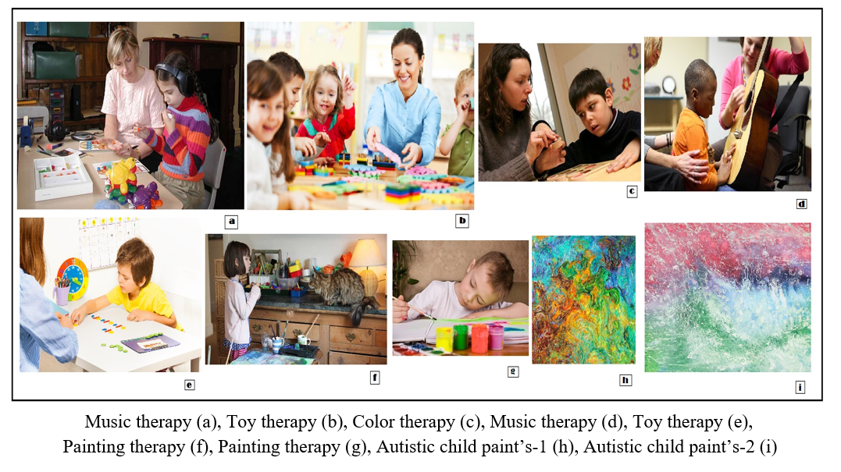
Introduction
9
Using Genetic Programming for Making a New Evolutionary Artwork, Based on Human-Computer Interactions for Autism Rehabilitation

Slide 10
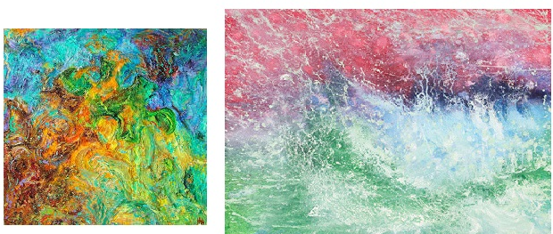
Introduction
10
Using Genetic Programming for Making a New Evolutionary Artwork, Based on Human-Computer Interactions for Autism Rehabilitation

Slide 11
Prior Related Researches
Related works:
EA
Karl Sims and William Latham (EA 1990)
David Hart (EA 2006)
Bacon (2003 EA)
Davidson (1999 EA)
Kleiweg (2006 EA)
Maxwell (2006 EA)
Mills (2006 EA)
Saunders (2006 EA)
Autism therapy
Wang, Michelle 2013-autism rehabilitation - virtual reality - rehabilitation
Jason M. O’Kane, et al-2011-adaptive robot design with hand and face tracking
Boucenna, Sofiane, et al-2014- review on interactive technologies for autistic children
Scassellati, Brian et al-2012- autism therapy by analyzing robot design decisions, human-robot interactions
11
Using Genetic Programming for Making a New Evolutionary Artwork, Based on Human-Computer Interactions for Autism Rehabilitation

Slide 12
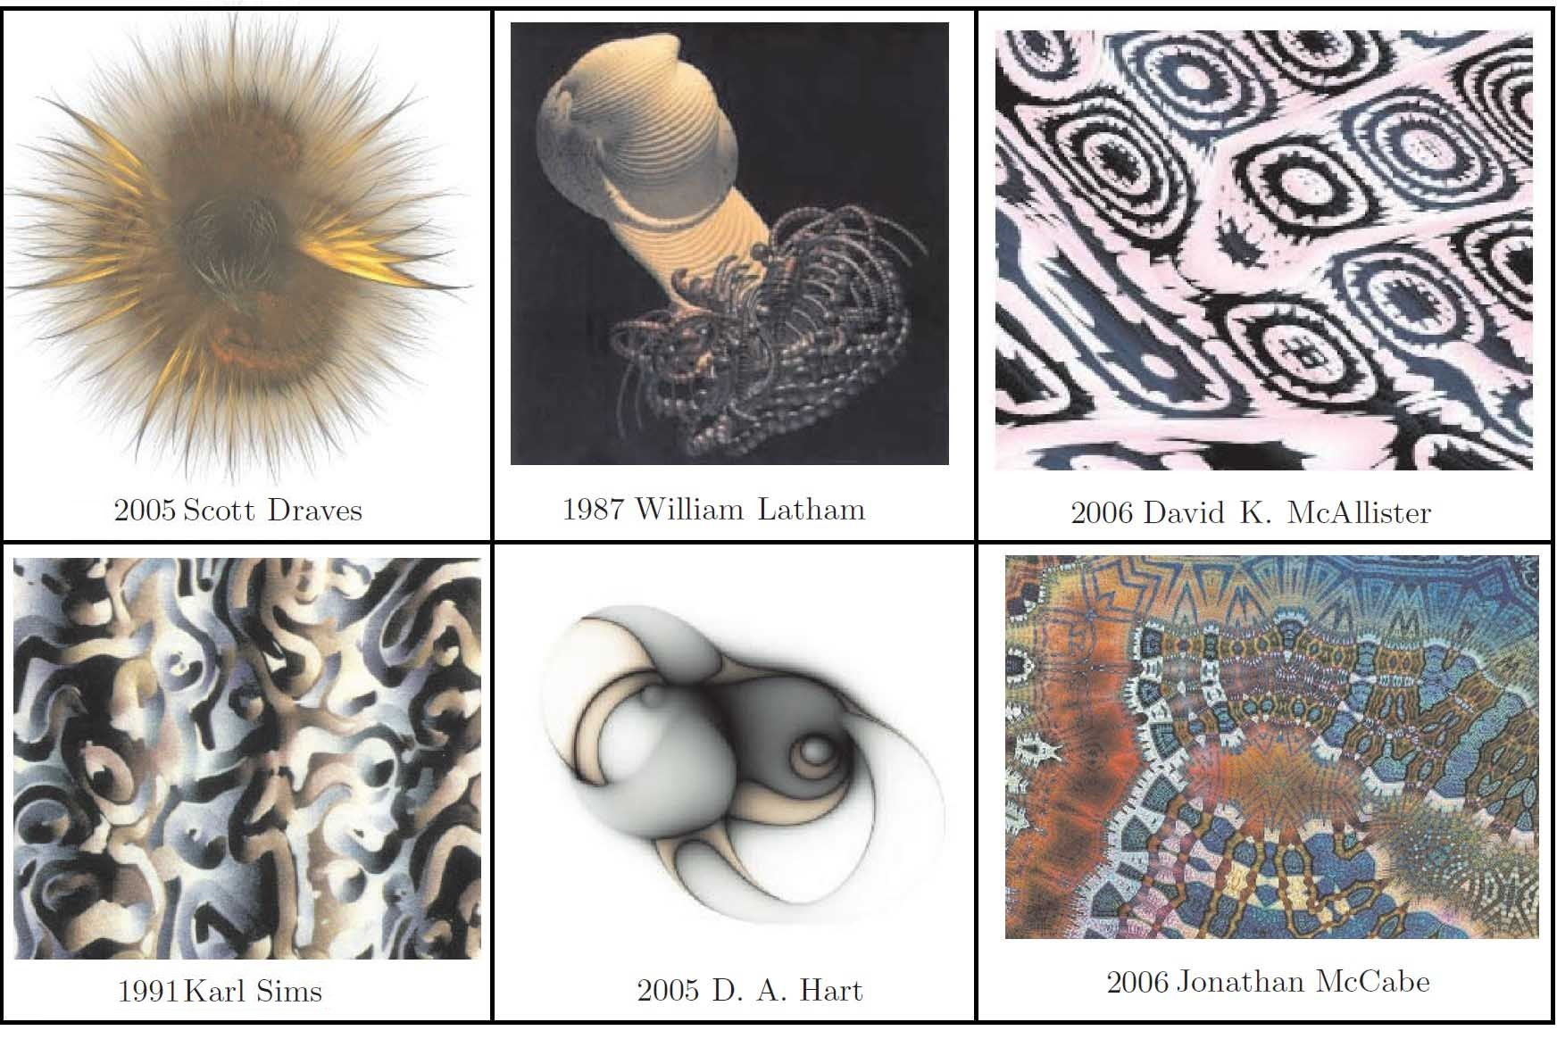
Prior Related Researches
12
Using Genetic Programming for Making a New Evolutionary Artwork, Based on Human-Computer Interactions for Autism Rehabilitation

Slide 13
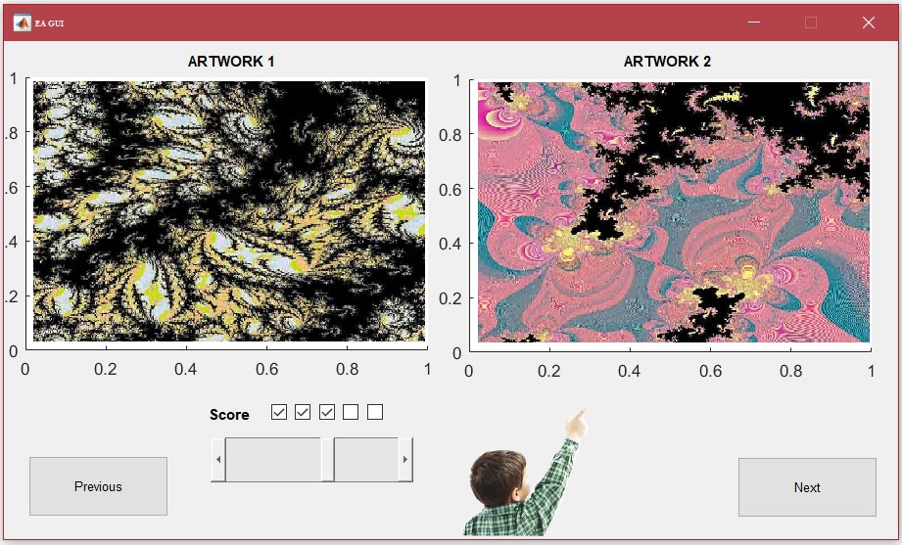
Proposed Method
Terminal and Function sets:
This paper first introduces an evolutionary art structure or visual art using genetic algorithm
Terminal sets
The terminals variables x and y refer to the (x, y) coordinate of image pixels and ‘Width’ and ‘height’
Phenotype variables
Function sets
Function sets are +, -, *, /, min, max, abs, neg, warp, sign, sqrt, pow, mdist, sin, cos
To make final phenotype result
The resulting image is passed to the fitness function (aesthetic measures) for validation
13
Using Genetic Programming for Making a New Evolutionary Artwork, Based on Human-Computer Interactions for Autism Rehabilitation

Slide 14
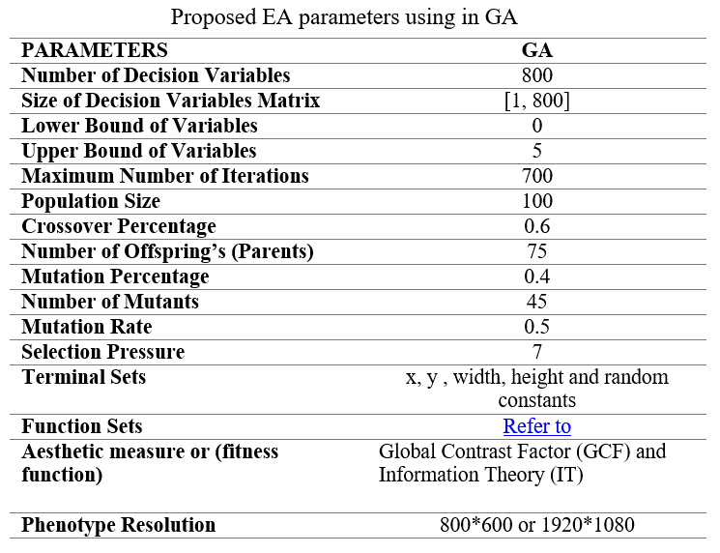
Proposed Method
14
Using Genetic Programming for Making a New Evolutionary Artwork, Based on Human-Computer Interactions for Autism Rehabilitation

Slide 15
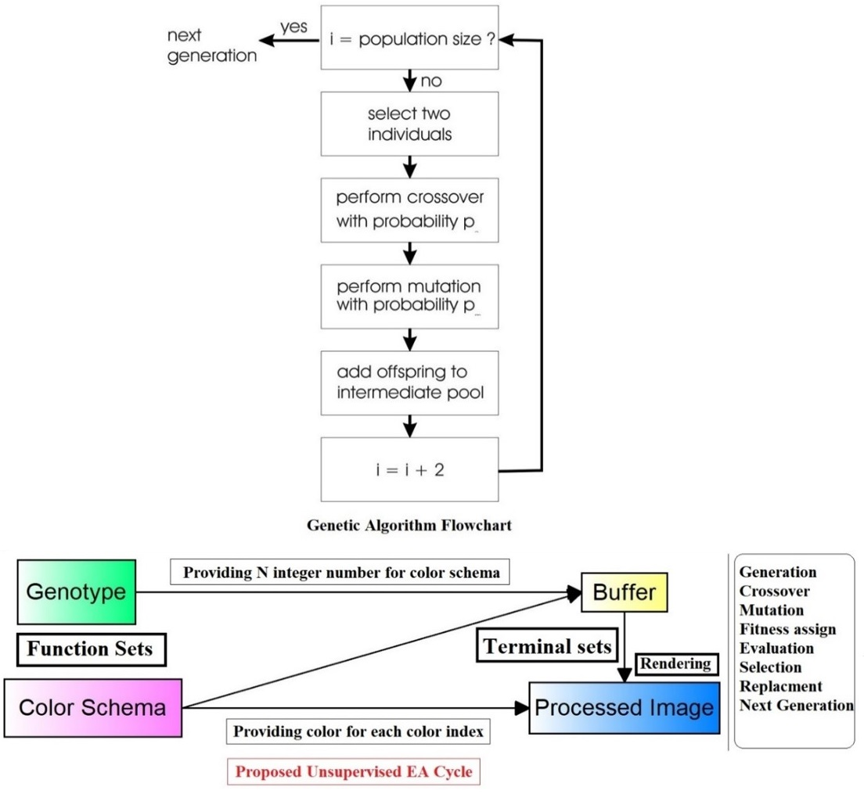
Proposed Method
15
Using Genetic Programming for Making a New Evolutionary Artwork, Based on Human-Computer Interactions for Autism Rehabilitation

Slide 16
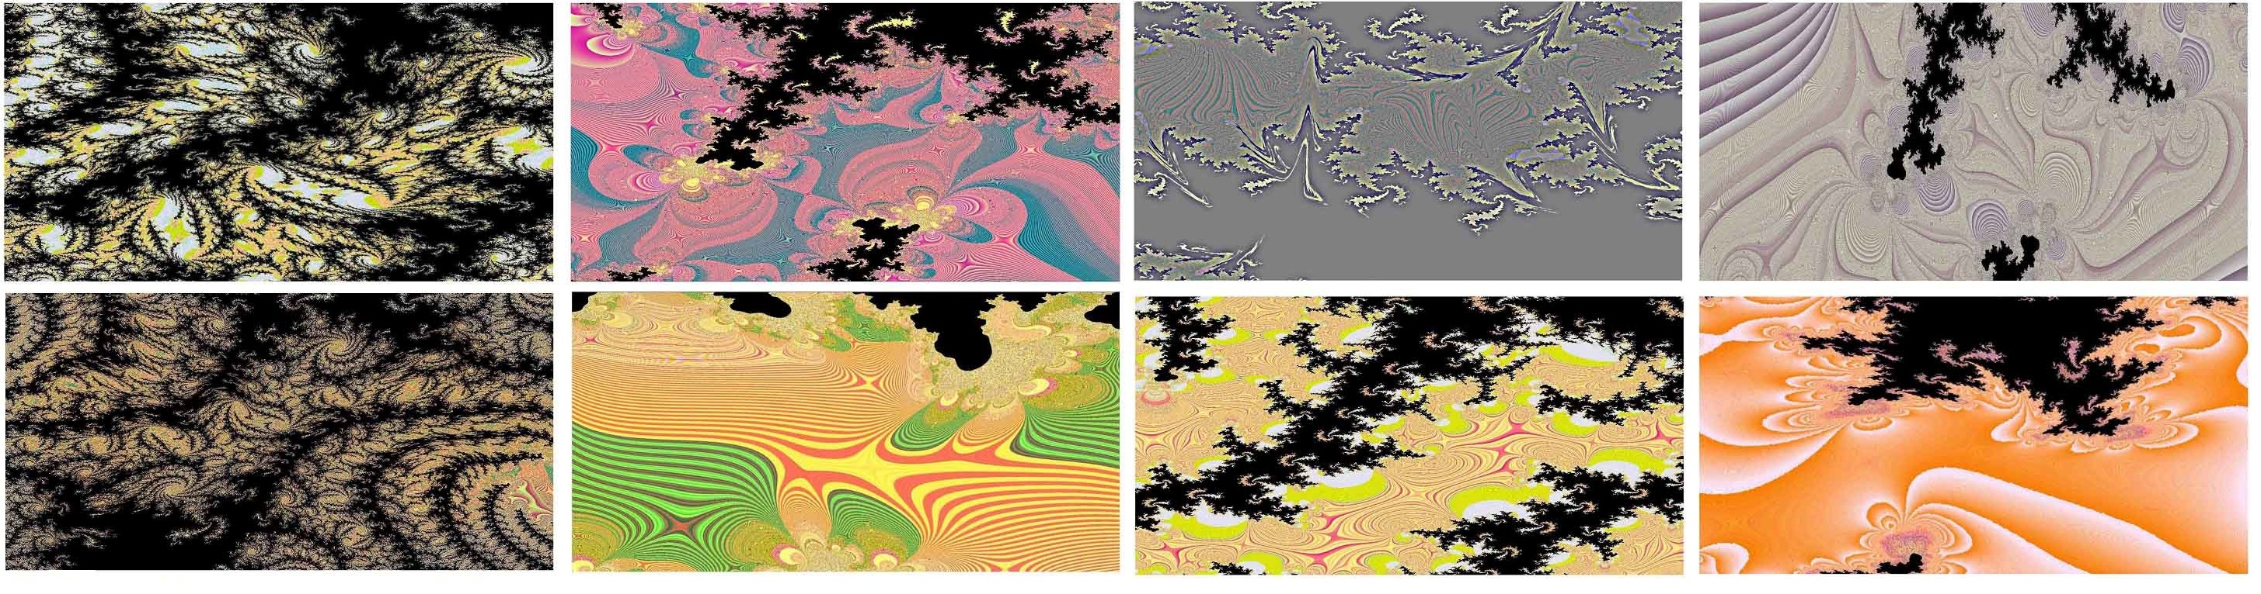
Proposed Method
16
Using Genetic Programming for Making a New Evolutionary Artwork, Based on Human-Computer Interactions for Autism Rehabilitation

Slide 17
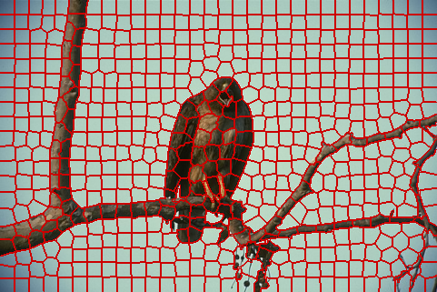
Validation and Results
Aesthetic measure (fitness function):
Aesthetic measures = Functions that assign an aesthetic value to an object
Used for validating EA structure as fitness function
The aesthetic measures are Global Contrast Factor (GCF) and Information Theory (IT)
Global Contrast Factor (GCF)
GCF calculates contrast (difference in luminance or brightness)
Less differences in luminance have low contrast and are considered ‘boring’ - So have a less aesthetic value
Contrast is calculated by computing the (average) difference in luminance between two neighboring superpixels
Superpixels are rectangular blocks in the image
17
Using Genetic Programming for Making a New Evolutionary Artwork, Based on Human-Computer Interactions for Autism Rehabilitation

Slide 18
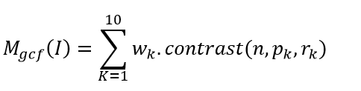
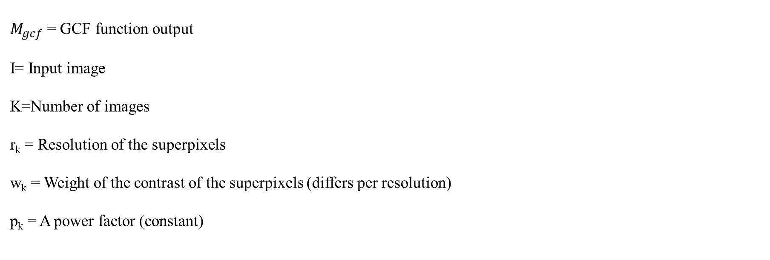
Validation and Results
The average contrast for several resolutions is summed as:
$M_{gcf}$= GCF function output
I= Input image
K=Number of images
r_{k} = Resolution of the superpixels
w_{k} = Weight of the contrast of the superpixels (differs per resolution)
p_{k} = A power factor (constant)
18
Using Genetic Programming for Making a New Evolutionary Artwork, Based on Human-Computer Interactions for Autism Rehabilitation

Slide 19
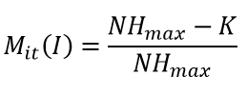
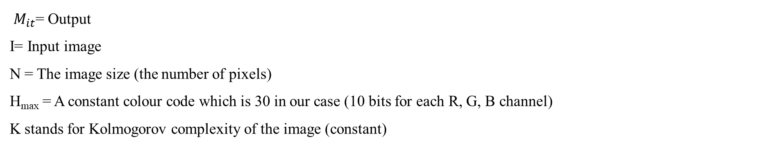
Validation and Results
Information Theory (IT):
Average amount of information produced by a random source of data
Optimizes images that have a low color compression ratio
Kolmogorov complexity using RGB entropy version of IT is used here:
$M_{it}$= Output
I= Input image
N = The image size (the number of pixels)
H_{max} = A constant colour code which is 30 in our case (10 bits for each R, G, B channel)
K stands for Kolmogorov complexity of the image (constant)
19
Using Genetic Programming for Making a New Evolutionary Artwork, Based on Human-Computer Interactions for Autism Rehabilitation

Slide 20
Validation and Results
Test condition:
15 runs for each aesthetic measure is performed
Collected the images of the 8 fittest individuals of each run
From the 40 images of each experiment (15 runs, 8 fittest individuals) handpicked 8 images
All evolutionary parameters were the same for each run
Populations of around 100 usually tended to converge better for individuals and their offspring
For the genetic operators mutation (rate 0.5), sub tree crossover (rate 0.6) is used.
Selection based on roulette wheel selection for both parent selection and survivor selection is used
Next generation is selected based on bests from present and new individuals
20
Using Genetic Programming for Making a New Evolutionary Artwork, Based on Human-Computer Interactions for Autism Rehabilitation

Slide 21
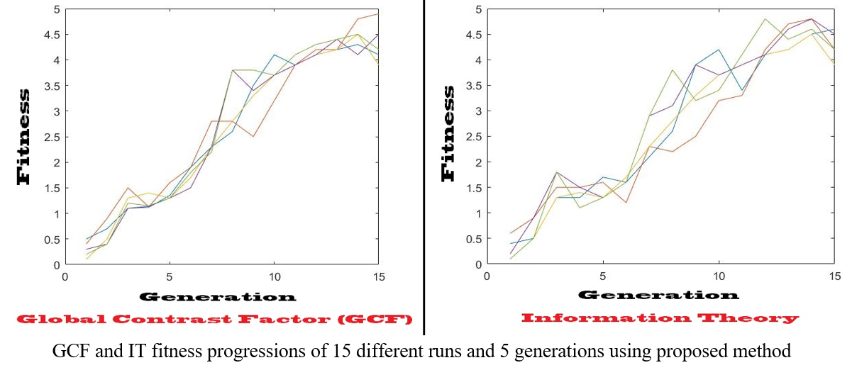
Validation and Results
Fitness functions results:
21
Using Genetic Programming for Making a New Evolutionary Artwork, Based on Human-Computer Interactions for Autism Rehabilitation

Slide 22
Validation and Results
Therapy result
3 autistic subjects (2 male and 1 female) in 3 days get EA treatments
Results was different in each child (positives and negatives)
But and the end proper patterns have founded for therapy
First subject gets 29% treatments after 3 days. Child was attracted to smooth shapes, light colors with lowest EA complexity and vice versa
Second subject had similar result pattern’s to subject 1, but treatment estimation after day 3 was not satisfactory and just 12% (maybe because of girly nature of the subject)
Third male subject had very good interests in colors and shape and returned 35% of therapy estimation after day 3.
So all subjects (male or female) tend to smooth shapes, light colors and less shape complexity
22
Using Genetic Programming for Making a New Evolutionary Artwork, Based on Human-Computer Interactions for Autism Rehabilitation

Slide 23
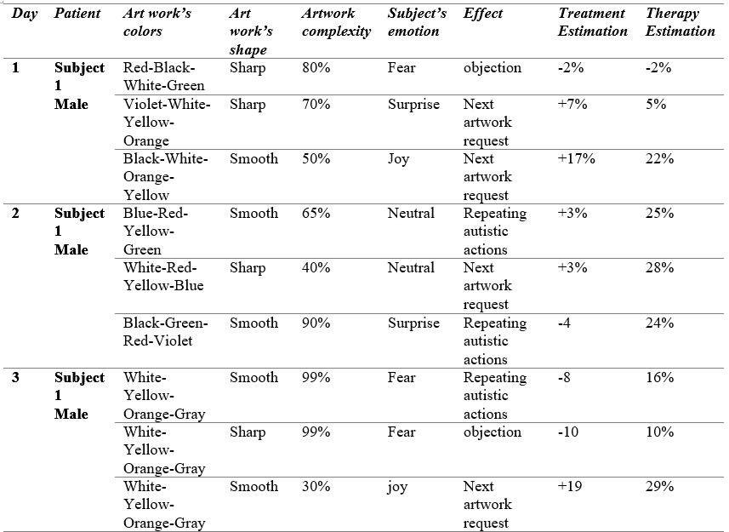
Validation and Results
Subject 1
23
Using Genetic Programming for Making a New Evolutionary Artwork, Based on Human-Computer Interactions for Autism Rehabilitation

Slide 24
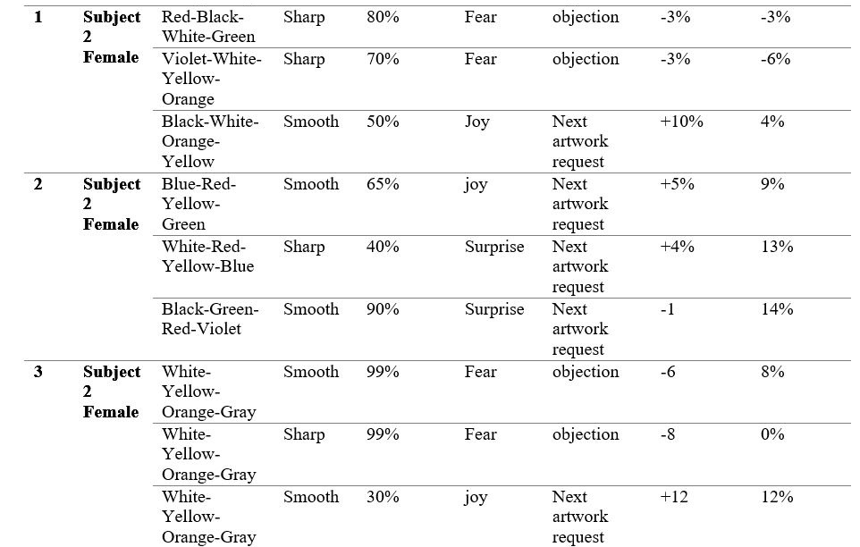
Validation and Results
Subject 2
24
Using Genetic Programming for Making a New Evolutionary Artwork, Based on Human-Computer Interactions for Autism Rehabilitation

Slide 25
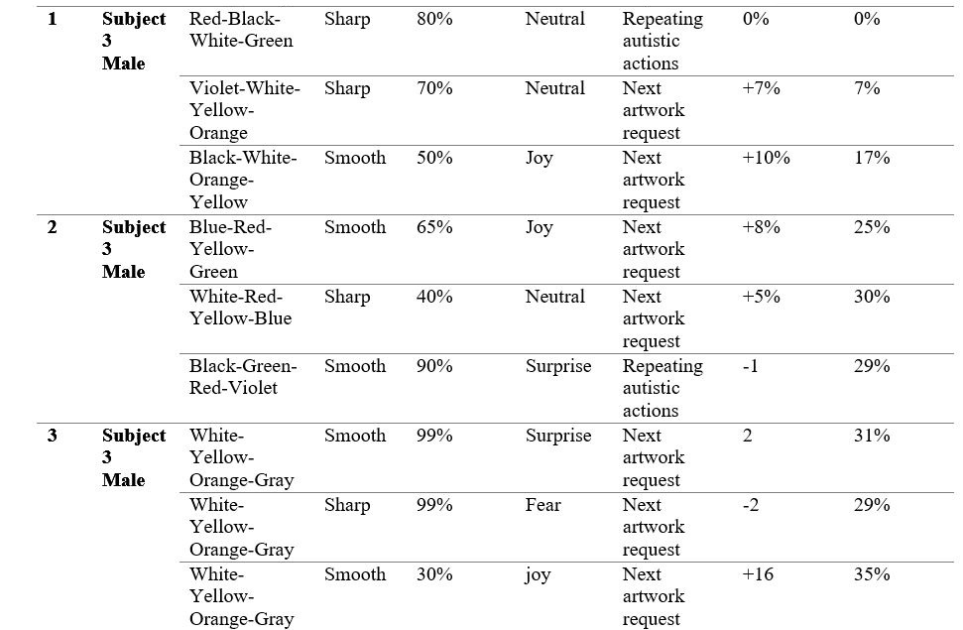
Validation and Results
Subject 3
25
Using Genetic Programming for Making a New Evolutionary Artwork, Based on Human-Computer Interactions for Autism Rehabilitation

Slide 26
Conclusion
Conclusion
Using A.I and image processing had good effects in autism therapy in last two decades
An evolutionary art structure used it to autism therapy in this paper
Positives and negatives results had been shown in the 3 subjects
At the end proper pattern had been founded
All of the subjects tend to smoother and lighter artworks with lowest complexity and vice versa
Even it is possible to change the evolutionary algorithm to algorithms such as:
PSO, ACO, DE, ICA, GGO or Bat algorithm to use other sides of the nature to make different and even better systems
26
Using Genetic Programming for Making a New Evolutionary Artwork, Based on Human-Computer Interactions for Autism Rehabilitation

Slide 27
References
References:
[26] Dawkins, R. (1986). The Blind Watchmaker. Penguin Books.
[27] Sims, K. (1991). Artificial evolution for computer graphics. ACM Computer Graphics, 25(4): 319–328.
[28] Todd, S., Latham, W. (1992). Evolutionary Art and Computers. Academic Press.
[29] Lewis, Matthew. "Evolutionary visual art and design." The art of artificial evolution. Springer Berlin Heidelberg, 2008. 3-37.
[30] Hart, D. (2006). D. a. hart abstract art. http://dahart.com
[31] Bacon, D. (2003). geneticArt IV. http://www.accesscom.com/~darius/ hacks/evoart/
[32] Davidson, A. (1999). Biography – evolutionary image explorer. http://spaz. ca/aaron/SCS/biography/
[33] Kleiwig, P. (2006). Genetic art. http://www.let.rug.nl/kleiweg/genart/ genart.html
[34] Maxwell, J.A. (2006). Image evolve applet. http://www.acm.vt.edu/~jmaxwell/evolve/
[35] Mills, A. (2006). Evolutionary art gallery. http://www.ashleymills.com/?q= gallery
[36] Saunders, R. (2006). Evol. http://wwwpeople.arch.usyd.edu.au/~rob/ applets/genart/GenArt.html
[37] Ellingsen, E. (2006). Steike genetic art. http://steike.com/GeneticArt
[38] Gerstmann, D. (2004). Spawner. http://home.myuw.net/dgerstma/content/ graphics/programs/spawner.shtml
27
Using Genetic Programming for Making a New Evolutionary Artwork, Based on Human-Computer Interactions for Autism Rehabilitation

Slide 28
References
[39] McAllister, D. (2006). David McAllister’s Genetic Art. http://home.comcast. net/~davemc0/GenArt/
[40] Baluja, S., Pomerleau, D., Jochem, T. (1994). Towards automated artificial evolution for computer-generated images. Connection Science, 6(2 and 3): 325–354
[41] Greenfield, G.R. (1998). New directions for evolving expressions. In: BRIDGES: Mathematical Connections in Art, Music and Science
[42] Greenfield, G.R. (1999). On understanding the search problem for image spaces. In: BRIDGES: Mathematical Connections in Art, Music and Science
[43] Greenfield, G.R. (2000). Mathematical building blocks for evolving expressions. In: BRIDGES: Mathematical Connections in Art, Music and Science
[44] Machado, P., Cardoso, A. (2003). NEvAr – system overview. In: Proceedings of Generative Art 2003. Milan, Italy
[45] Wang, Michelle, and Denise Reid. "Using the virtual reality-cognitive rehabilitation approach to improve contextual processing in children with autism." The Scientific World Journal 2013 (2013).
[46] Boccanfuso, Laura, and Jason M. O’Kane. "CHARLIE: An adaptive robot design with hand and face tracking for use in autism therapy." International journal of social robotics 3.4 (2011): 337-347.
28
Using Genetic Programming for Making a New Evolutionary Artwork, Based on Human-Computer Interactions for Autism Rehabilitation

Slide 29
End
Thank You
?
29
Using Genetic Programming for Making a New Evolutionary Artwork, Based on Human-Computer Interactions for Autism Rehabilitation

